Slide 1
Linear Equations
Draw up 3 column notes
Topic: Solving Equations
EQ: How do we use Backtracking to solve equations?
Mrs Stretch
Year 7

Slide 2


From Last Lesson
Use a flow chart to build this expression:
$$30h+5$$

Slide 3
24
7
30
Solving Equations
Date
EQ – How do we use Backtracking to solve equations?
Examples
Steps
What are inverse operations?
To solve equations we need to undo the operations used to build the equation.
We use the inverse operations by moving backwards along the flowchart.
+
-
-
+
×
÷
÷
×

Slide 4
24
7
30
Solving Equations
Date
EQ – How do we use Backtracking to solve equations?
Examples
Steps
What are inverse operations?
To solve equations we need to undo the operations used to build the equation.
We use the inverse operations by moving backwards along the flowchart.
+
-
-
+
×
÷
÷
×

Slide 5








24
7
30
Solving Equations
Date
EQ – How do we use Backtracking to solve equations?
Examples
Steps
What are inverse operations?
$$2x+5$$
+
-
$$×2$$
$$+5$$
-
+
$$x$$
$$2x$$
$$2x+5$$
×
÷
$$÷2$$
$$−5$$
÷
×

Slide 6
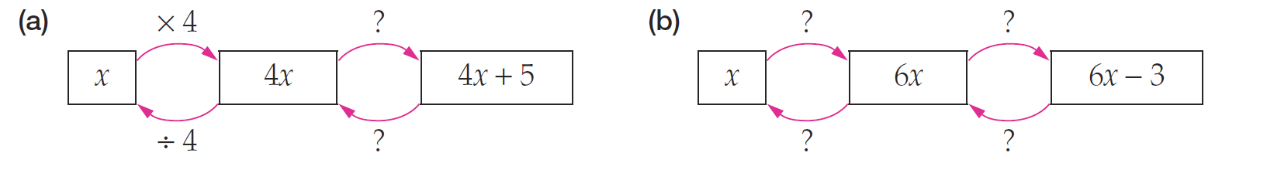
Practice

Slide 7











24
7
30
Solving Equations
Date
EQ – How do we use Backtracking to solve equations?
Examples
Steps
How do we Backtrack?
Step 1: Draw the flowchart boxes and the arrows
Step 2: Fill in the top boxes and write the answer in the last bottom box
Step 3: Write the inverse operations on the chart
Step 4: Fill in the boxes following the arrows
$$2x+5=11$$
$$×2$$
$$+5$$
$$x$$
$$2x$$
$$2x+5$$
$$3$$
$$6$$
$$11$$
$$÷3$$
$$−5$$

Slide 8








24
7
30
Solving Equations
Date
EQ – How do we use Backtracking to solve equations?
Examples
Steps
How do we Backtrack?
Step 1: Draw the flowchart boxes and the arrows
Step 2: Fill in the top boxes and write the answer in the last bottom box
Step 3: Write the inverse operations on the chart
Step 4: Fill in the boxes following the arrows
$$3x+4=13$$
$$×3$$
$$+4$$
$$x$$
$$3x$$
$$3x+4$$
$$3$$
$$9$$
$$13$$
$$÷3$$
$$−4$$

Slide 9

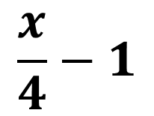






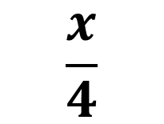

24
7
30
Solving Equations
Date
EQ – How do we use Backtracking to solve equations?
Examples
Steps
How do we Backtrack?
Step 1: Draw the flowchart boxes and the arrows
Step 2: Fill in the top boxes and write the answer in the last bottom box
Step 3: Write the inverse operations on the chart
Step 4: Fill in the boxes following the arrows
$$\frac{x}{4}−1=2$$
$$÷4$$
$$−1$$
$$x$$
$$\frac{x}{4}$$
$$\frac{x}{4}−1$$
$$12$$
$$3$$
$$2$$
$$×4$$
$$+1$$

Slide 10


Slide 11
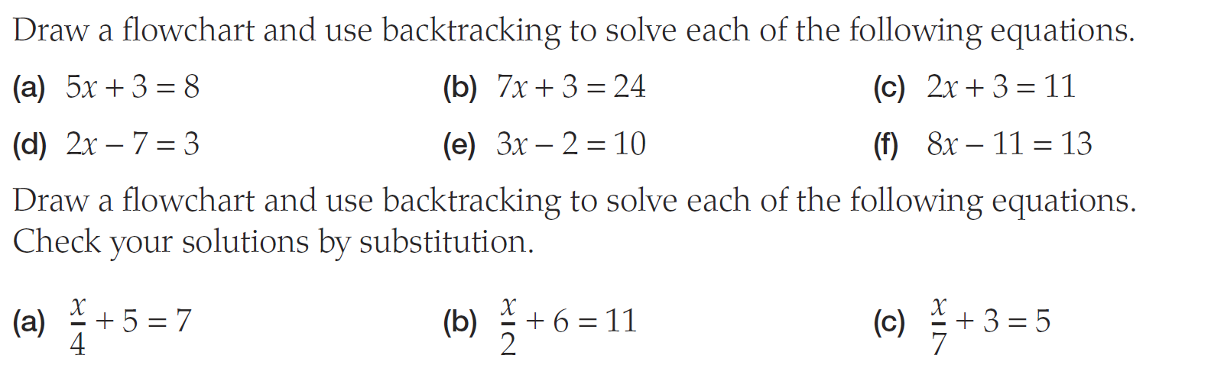
Task

